Slide 1
Database Systems
Lecture 22
Functional Dependencies

Slide 2
Today’s Agenda
Informal Design Guidelines for Relational Databases
Semantics of the Relation Attributes
Reducing the Redundant Information in Tuples and Update Anomalies
Reducing the Null Values in Tuples
Disallowing the possibility of generating Spurious Tuples
Functional Dependencies

Slide 3
Null Values in Tuples
GUIDELINE 3: Relations should be designed such that their tuples will have as few NULL values as possible
Attributes that are NULL frequently could be placed in separate relations (with the primary key)
Reasons for nulls:
attribute not applicable or invalid
attribute value unknown (may exist)
value known to exist, but unavailable

Slide 4
Spurious Tuples
Bad designs for a relational database may result in erroneous results for certain JOIN operations
The "lossless join" property is used to guarantee meaningful results for join operations
GUIDELINE 4: The relations should be designed to satisfy the lossless join condition. No spurious tuples should be generated by doing a natural-join of any relations.

Slide 5
Spurious Tuples (2)
There are two important properties of decompositions:
non-additive or losslessness of the corresponding join
preservation of the functional dependencies.
Note that property (a) is extremely important and cannot be sacrificed. Property (b) is less stringent and may be sacrificed.

Slide 6
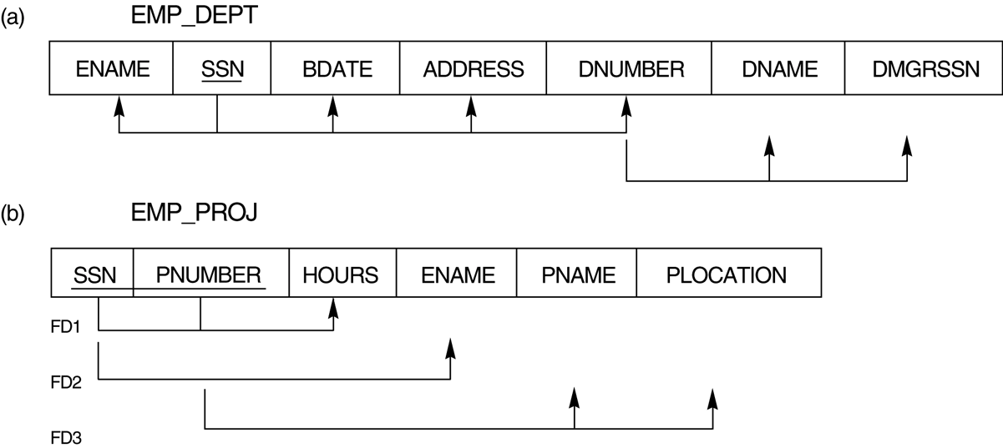

Slide 7
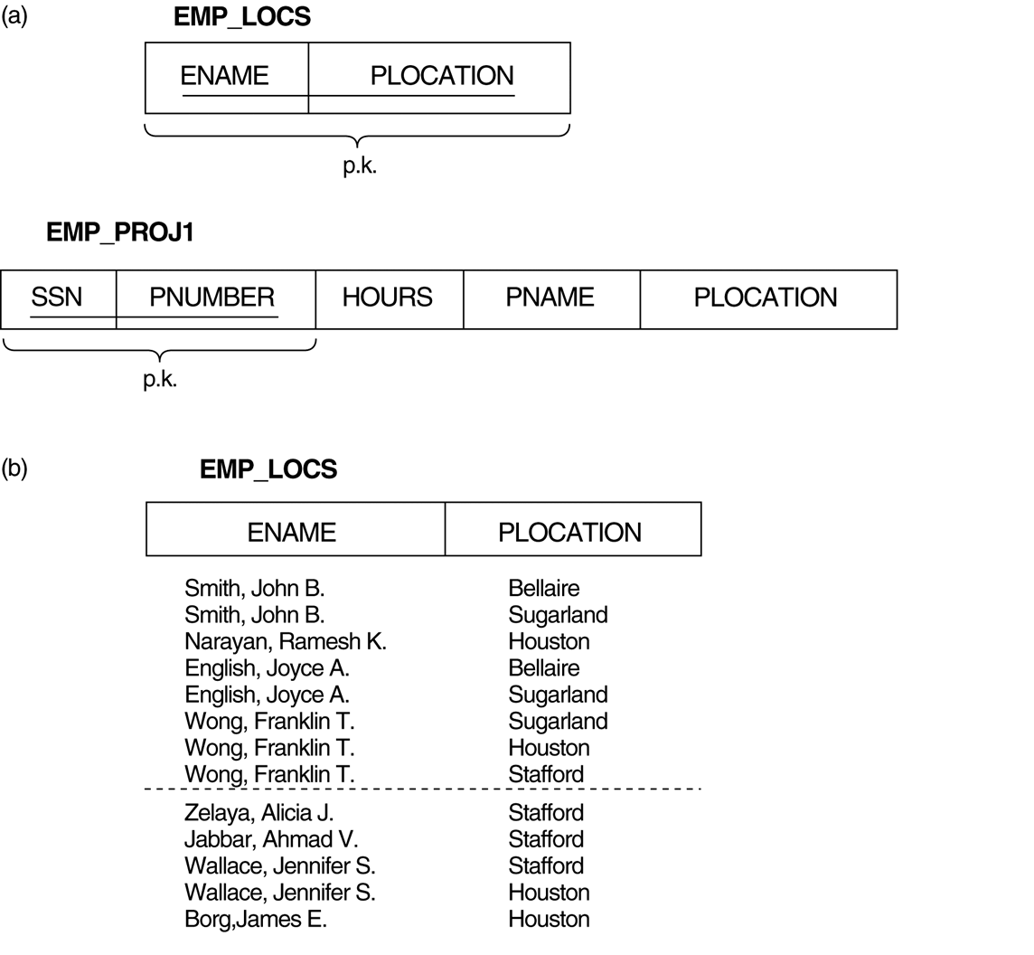
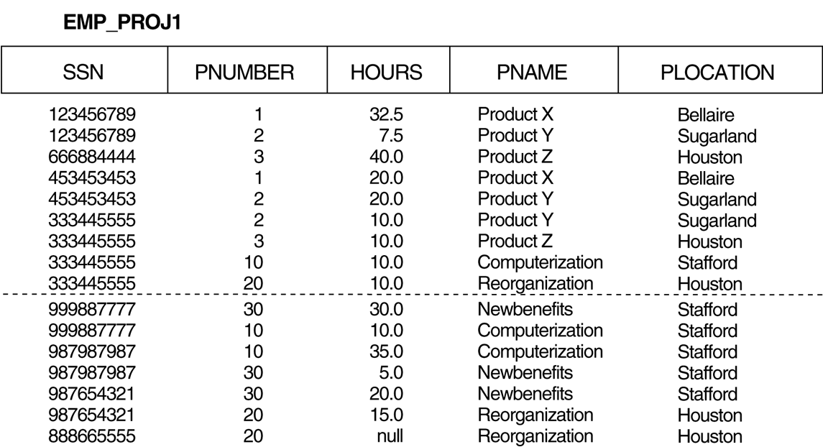
Particularly poor design for the EMP_PROJ relation of Figure 10.3b.

Slide 8
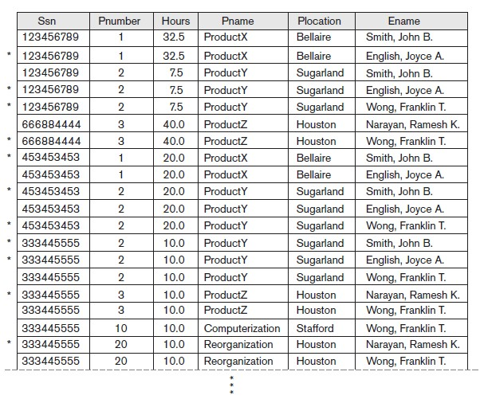
Result of applying NATURAL JOIN to the tuples above the dotted lines in EMP_PROJ1 and EMP_LOCS of Figure 10.5. Generated spurious tuples are marked by asterisks.

Slide 9
Functional Dependencies (1)
Functional dependencies (FDs) are used to specify formal measures of the "goodness" of relational designs
FDs and keys are used to define normal forms for relations
FDs are constraints that are derived from the meaning and interrelationships of the data attributes
A set of attributes X functionally determines a set of attributes Y if the value of X determines a unique value for Y

Slide 10
Functional Dependencies (2)
X -> Y holds if whenever two tuples have the same value for X, they must have the same value for Y
For any two tuples t1 and t2 in any relation instance r(R): If t1[X]=t2[X], then t1[Y]=t2[Y]
X -> Y in R specifies a constraint on all relation instances r(R)
Written as X -> Y; can be displayed graphically on a relation schema as in Figures. ( denoted by the arrow: ).
FDs are derived from the real-world constraints on the attributes

Slide 11
Figure 10.3 Two relation schemas suffering from update anomalies

Slide 12
Examples of FD constraints (1)
social security number determines employee name
SSN -> ENAME
project number determines project name and location
PNUMBER -> {PNAME, PLOCATION}
employee ssn and project number determines the hours per week that the employee works on the project
{SSN, PNUMBER} -> HOURS

Slide 13
Examples of FD constraints (2)
FD is a property of the attributes in the schema R
The constraint must hold on every relation instance r(R)
If K is a key of R, then K functionally determines all attributes in R (since we never have two distinct tuples with t1[K]=t2[K])

Slide 14
Inference Rules for FDs (1)
Given a set of FDs F, we can infer additional FDs that hold whenever the FDs in F hold
Armstrong's inference rules (proposed in 1974):
IR1. (Reflexive) If Y subset-of X, then X -> Y
IR2. (Augmentation) If X -> Y, then XZ -> YZ
(Notation: XZ stands for X U Z)
IR3. (Transitive) If X -> Y and Y -> Z, then X -> Z
IR1, IR2, IR3 form a sound and complete set of inference rules

Slide 15
Inference Rules for FDs (2)
Some additional inference rules that are useful:
(Decomposition) If X -> YZ, then X -> Y and X -> Z
(Union) If X -> Y and X -> Z, then X -> YZ
(Psuedotransitivity) If X -> Y and WY -> Z, then WX -> Z
The last three inference rules, as well as any other inference rules, can be deduced from IR1, IR2, and IR3 (completeness property)

